Slide 1

Understanding & Finding Performance Bottlenecks
Revised for:
Software Test & Performance Conference
April 2007, San Mateo, CA
First Presented for:
IBM Rational Users Conference, 2004
Scott Barber
Chief Technologist
PerfTestPlus, Inc.

Slide 2
Introduction
This presentation is derived from:
“User Experience, not Metrics”: Parts 6, 8, 9, & 10,
and “Beyond Performance Testing”: Parts 6-10, located at http://www.perftestplus.com/pubs.htm.

Slide 3
Agenda
Overview
Scott’s Rules of Bottlenecks
Analyzing Results to Identify Bottlenecks
What the Development Team Needs to Know
Identify the Tier of a Detected Issue
Identify the Component of a Detected Issue
Available Tools
Summary

Slide 4
Overview
One part of the system is always slowest
(the bottleneck).
Until it is remedied, no other tuning will actually improve the overall performance of the application along that path.
Before that bottleneck can be tuned, it must first be conclusively identified.

Slide 5
Overview
Once a bottleneck is identified,
resolution can be reached more quickly
if your existing tests
are modified to eliminate distraction
from ancillary issues.
Pinpointing exactly where the bottleneck is
is an art all its own.

Slide 6
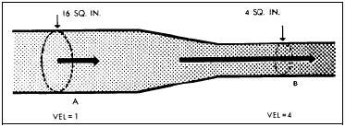
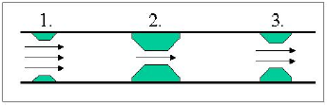
Scott’s Rules of Bottlenecks
A bottleneck is a slowdown. A stoppage is a failure.
Bottlenecks don’t exist exclusively under load.
The symptoms of the bottleneck are
(virtually) never observed at the
actual location of the bottleneck.
The critical bottleneck is the one along a particular user path whose removal will both improve
performance and enable the
identification of other bottlenecks.
If you suspect a bottleneck in a system with multiple paths, isolate the paths and evaluate them separately.

Slide 7
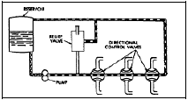
Scott’s Rules of Bottlenecks
A bottleneck is more likely
to be found in the hardware
or software than in the
network, but the network
is easier to check.
Not all observed slow spots are caused by bottlenecks; bottlenecks, by definition, affect other activities, users or system components.
When reporting bottleneck suspects, don’t assume you know the cause. Just report the symptoms.

Slide 8
Analyzing Results to ID Bottlenecks
Use visual representations of data!!
Edward Tufte, Ph.D., Professor Emeritus of political science, computer science and statistics, and graphic design at Yale.
According to ET:
Power Corrupts...

Slide 9
Analyzing Results to ID Bottlenecks
PowerPoint Corrupts Absolutely.

Slide 10
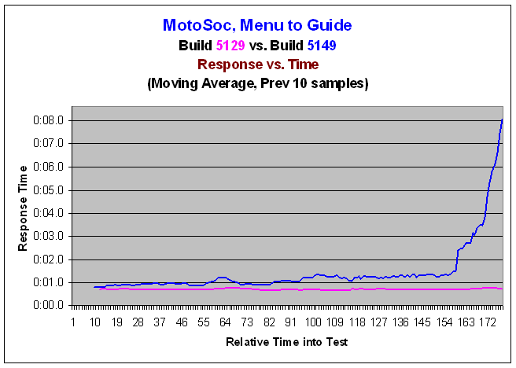
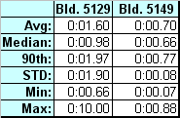
Analyzing Results to ID Bottlenecks
Examine Response vs. Time Charts/Tables

Slide 11
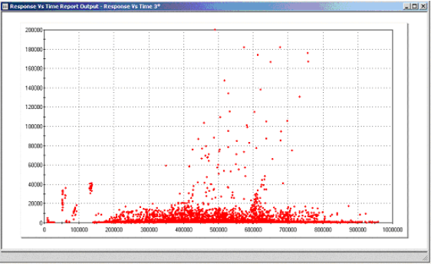
Analyzing Results to ID Bottlenecks
Study Scatter Charts

Slide 12
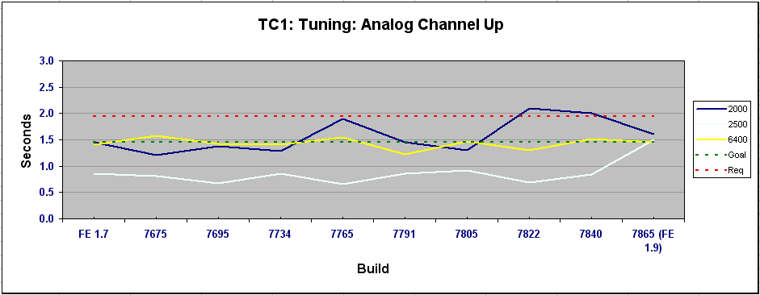
Analyzing Results to ID Bottlenecks
Evaluate Patterns and Trends

Slide 13
Analyzing Results to ID Bottlenecks
Rely on personal observation
Listen to third party comments
Confirm suspects
Reproduce results
  Exactly
  Manually
  With similar tests
  With minimalist tests
  With not-so-similar tests
Report suspects
  Verbally
  Visually
  Via demonstration

Slide 14
What the Dev Team Needs to Know
Which related activities produce the same symptoms?
Which other activities are affected by the bottleneck?
What were the load characteristics of the test that identified the symptoms?
What data did you use to create the symptoms?
What’s the configuration of the environment you’re testing?
Other metrics the developers wanted you to collect.

Slide 15
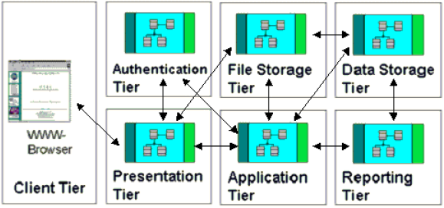
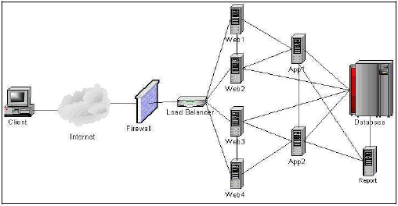
Identify the Tier of a Detected Issue
Logical
Architecture
Physical Architecture

Slide 16
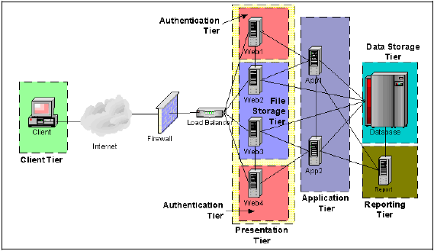
Identify the Tier of a Detected Issue
Physical Architecture with Logical Overlay

Slide 17
Identify the Tier of a Detected Issue
Design tests to determine tier
  Ask “What if…?” Questions.
  Ask developers to speculate
  Evaluate commands with slow responses
  Think in terms of distinguishing failures, slow spots, and bottlenecks
  Visualize and prioritize
Modify existing tests
Create new tests by:
  using the same tool
  using a different tool
  using a test harnesses

Slide 18
Identify the Tier of a Detected Issue
Speak intelligently with the development team
Capture metrics by tier
  Resource utilization
  Response times
  Others identified by developers
Interpret metrics
  Look for the obvious
  Consult development team
  Change tests to prove (or disprove) theories

Slide 19
ID the Component of a Detected Issue
Once the tier is identified further narrowing may be required to identify the specific component. The same principles as tier identification apply:
Speak intelligently with the development team
Capture metrics by component
  Resource utilization
  Response times
  Others identified by developers
Interpret metrics
  Look for the obvious
  Consult development team
  Change tests to prove (or disprove) theories

Slide 20
Available Tools
Common
  LoadRunner, Silk Performer, Rational Performance Tester, OpenSTA, Visual Studio Team System, eLoad
  Purify, Quantify, PerformAssure
  J-Meter, Perfmon, Perfmeter, Top
  WebTrends, WebLogic, Tivoli, MOM
Other performance test/monitoring tool types
  Load generation
  Performance monitoring
  Performance analysis
  OS/system specific tools
  Application specific tools

Slide 21
Available Tools
Other analysis tools
  Spreadsheets
  Statistical calculators
  Mathematical graphing
  Graphical presentation
Most important tools
  Your brain
  Your development team

Slide 22
Want More Information?
Good sources for additional information about performance testing:
  http://www.PerfTestPlus.com
  http://www.codeplex.com/PerfTesting
  http://www.loadtester.com
  http://www.performancetester.com
Graphical Presentation of Information – Edward Tufte, PhD. http://www.edwardtufte.com (Books and seminars)

Slide 23
Summary
Report symptoms, not solutions/reasons
Verify observations
Analyze results collaboratively
Don’t over-depend on your initial tests
Determine related and unrelated activities
Analyze, analyze, analyze (collaboratively)
Know when to hand-off to the development team
Performance testing is a development support role
Document conclusions
Document recommendations

Slide 24

Questions

Slide 25
Contact Info
Scott Barber
Chief Technology Officer
PerfTestPlus, Inc
E-mail:
sbarber@perftestplus.com
Web Site:
www.PerfTestPlus.com

